Slide 1
AIR·Ton Ad
Group 3
Ankita Karolina
Marlon
Kundai Senikau

Slide 2
Presentation Outline
Introduction
The Questions Posed To Our Target Audience
25 Answers From Our Survey
Data Visuals of Answers Collected From Survey
Data Summarisation
Customer Profiles
Facebook Ads
Sample Facebook Ads
Benefits of Using Air-Ton

Slide 3
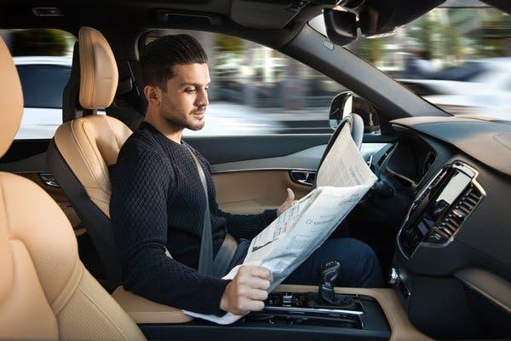
Introduction
The aim of our research was to determine whether people had enough trust in self-driven vehicles.
25 people contributed to this survey, answering open-ended questions about using autonomous technology.
Our initial hypothesis was that majority of our respondents would opt towards using robot drivers on daily basis.
Well, the answers were divided...
Notes:
people dont have enough trust in autonomous technology.
mostly the data we collected represents the city people
mostly the data we collected represents the city people, who commute daily by own car 50%
3. When driving your car, would you feel safe "only" when you drive, and why?
target audience with solution: Normal Driver Mode: give the driver robot a direction, and it will drive you there as fast as possible, taking into account all safety regulations

Slide 4
The Questions We Posed To Our Target Audience
The purpose of this survey is to know how comfortable are you in the adoption and deployment of automation technologies.
Question | The five open-ended questions
1 | How often (and why?) do you use automated services provided by machines, like an automatic car wash, automatic vacuum cleaner, Google Home?
2 | When driving your car, would you feel safe "only" when you drive, and why?
3 | How autonomous technology will affect you?
4 | To what extent are we ready to give up our driving habits? What would be the reason behind that?
5 | Robots aren't taking our jobs, but they are transforming the way we work in our lives" - what do you think about it? Do you have different opinion?
Notes:
From our research what did we realsie. Ad pie charts here

Slide 5
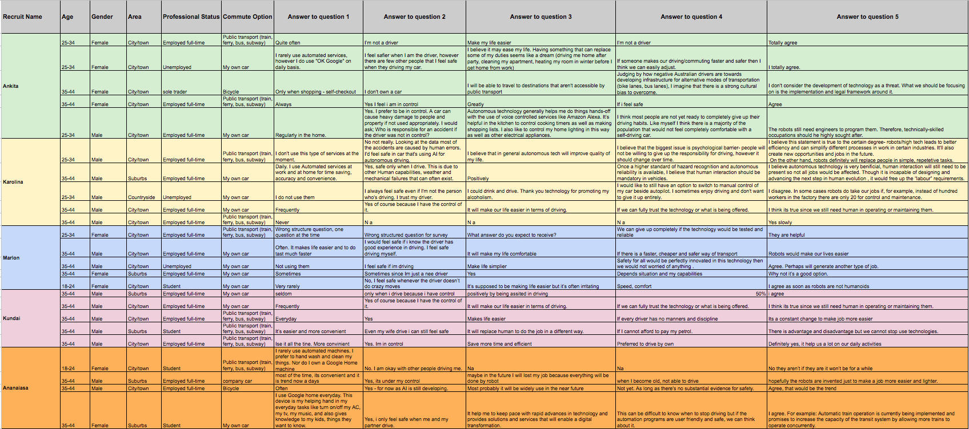
25 Answers From Our Survey
Notes:
From our research what did we realise. Ad pie charts here

Slide 6
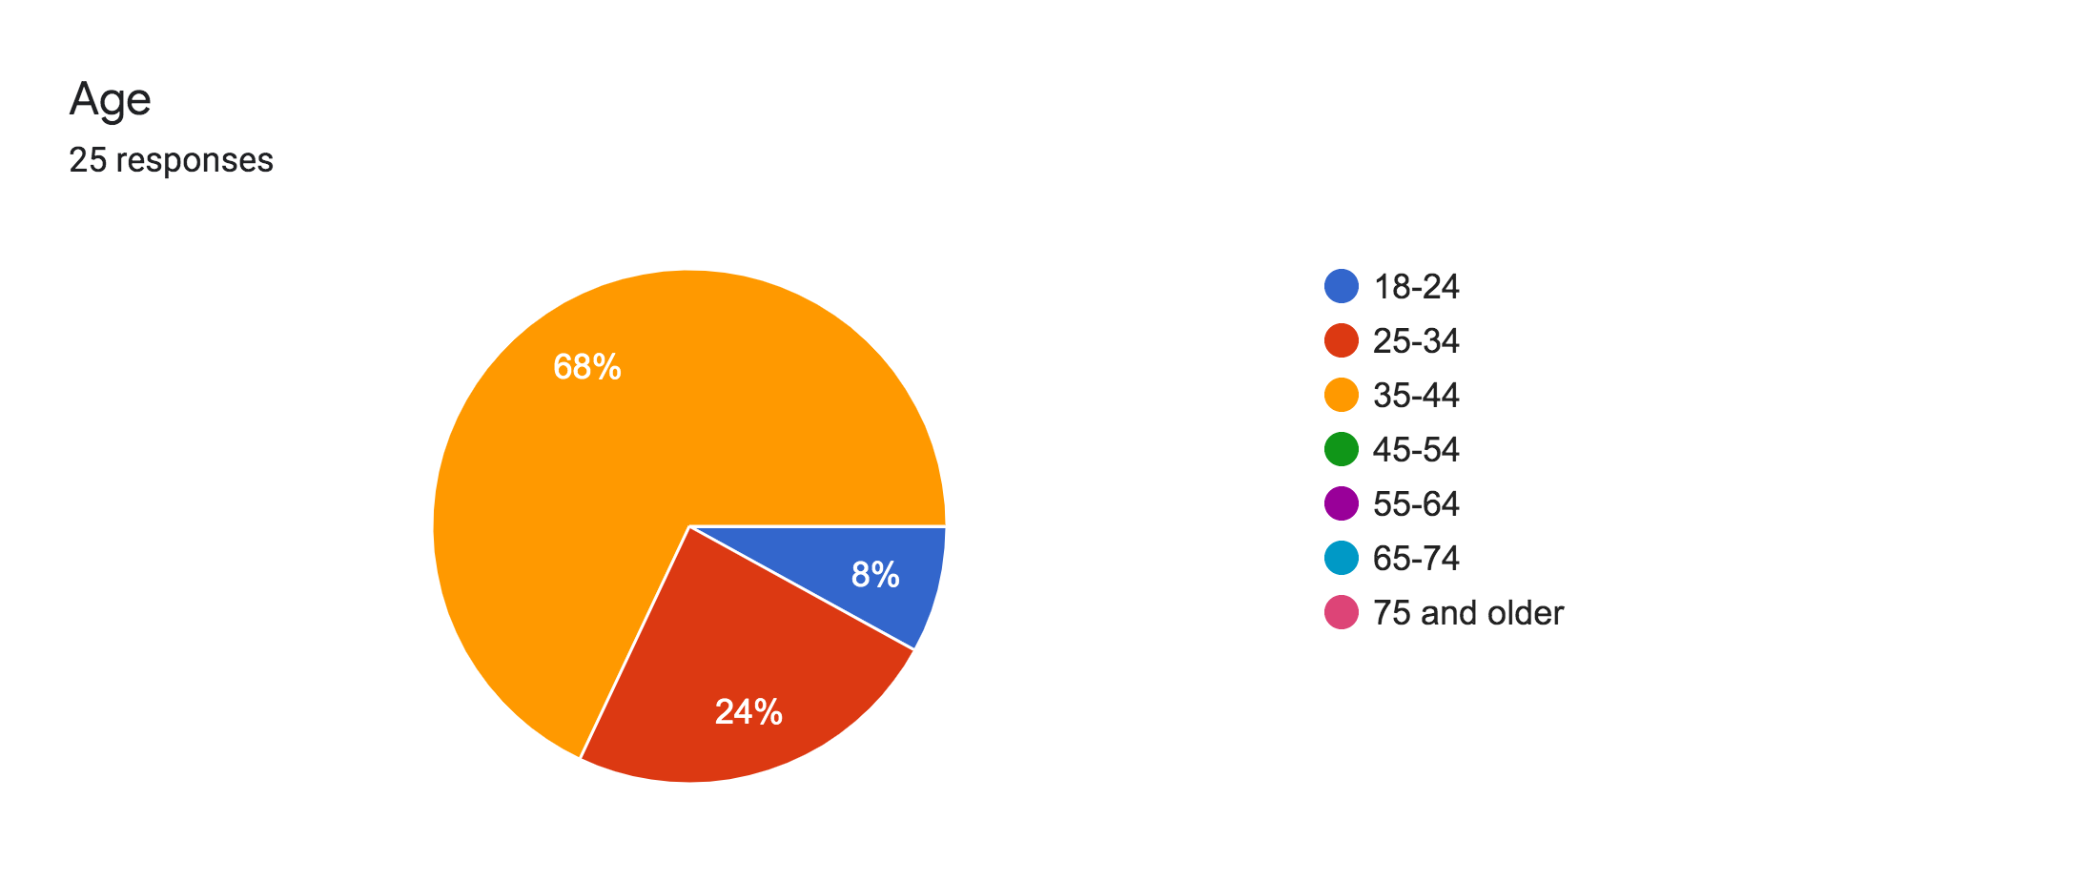
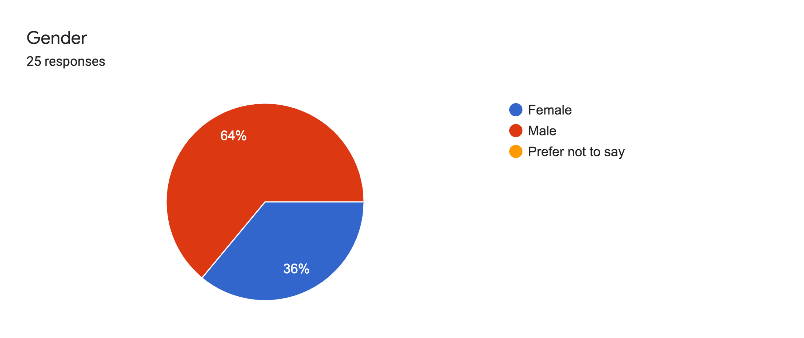
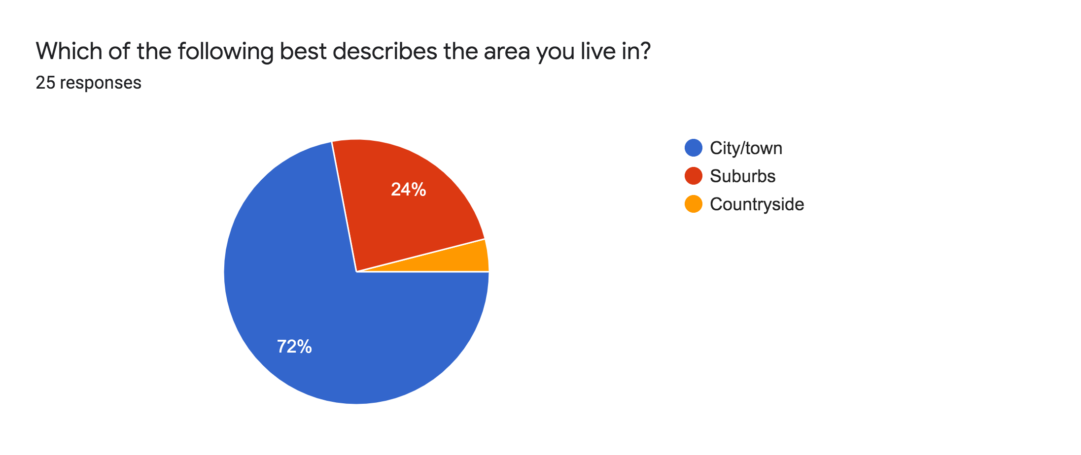
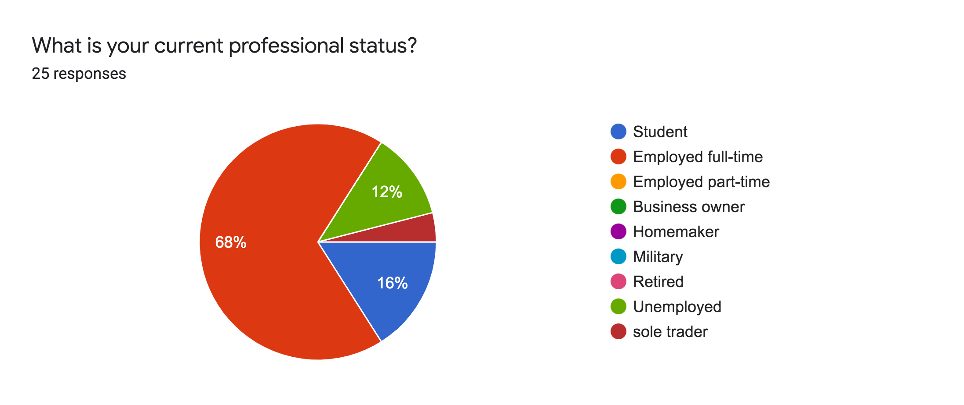
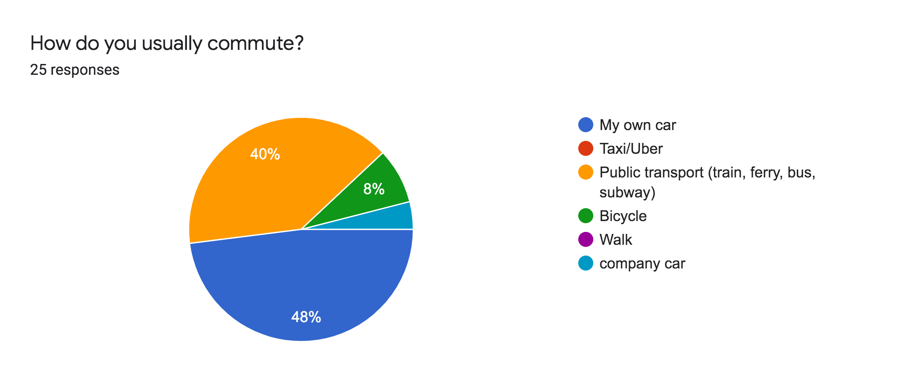
Data Collected From The Survey

Slide 7
Data Summarisation
Question | Summarised responses
1 | 14 respondents were using automated machines often or on daily basis. 3 of them never use them The rest of them (8 respondents) only use one or two types of automated machines and very rarely.
2 | 15 respondents feel safe only when they drive. The reason behind that is they are in control. 4 of them either don't own the car or don't drive. 1 respondent believes that AI can take “human error” from the equation. 4 respondents who feel safe when driving also feel safe when other people are.
3 | 18 respondents say that autonomous technology will make their lives easier. 2 of them believe that robots will take over humans jobs. One respondent finds autonomous technology rather irritating.
4 | 10 respondents think people are not ready to completely trust technology with driving. 13 respondents would change their driving habits once self-driving cars are safe and reliable. 1 respondent would change the habit if he/she had no money for fuel. 2 of them state that they would still prefer to drive themselves.
5 | 22 answers were agreeing with the statement. 2 respondents say there are advantages and disadvantages to that. 1 respondent disagreed with the statement, saying robots are taking our jobs..
Notes:
From our research what did we realsie. Ad pie charts here

Slide 8
5 Customer Profiles
Party Goer Commuter (2 people) | Efficiency Minded Commuter (19 people) | Disabled Commuter* | Business and chauffeured commuters (10 people) | Tourist Commuter (25 people)
This commuter is the customer who will use the AIR·Ton simply so they can enjoy chatting with their friends after late night drinks and a night on the town. This type of customer is likely declining due to lock down rules. | This commuter is wants to avoid wasting time and wishes to arrive at their destination quickly and efficiently. This commuter often opts to use an uber or other ride sharing apps because of how efficient they are. As offices and lockdown rules lift this customer will potentially need AIR·Ton more. | The disabled commuter is interested in the AIR·Ton because of how safely and hassle free they can move from place to place. This type of customer is likely demanding more of AIR·Tons services in order to lower the risk of infection that comes with having a driver. NB: This is a potential customer who may benefit from Air-ton and was not represented in our data | The business owner or chauffeured commuters are customers who already have private vehicles but may want to lower their costs by removing the chauffeur. They may also use AIR·Ton to have some privacy whilst commuting. This type of customer may be on the rise as offices begin to open again. | The tourist is someone who will sign up to use AIR·Ton because it is available and and accessible and do not know anyone at their place of arrival. This type of commuter is currently declining due to the fewer people traveling as a result of COVID19.
Notes:
From our research

Slide 9
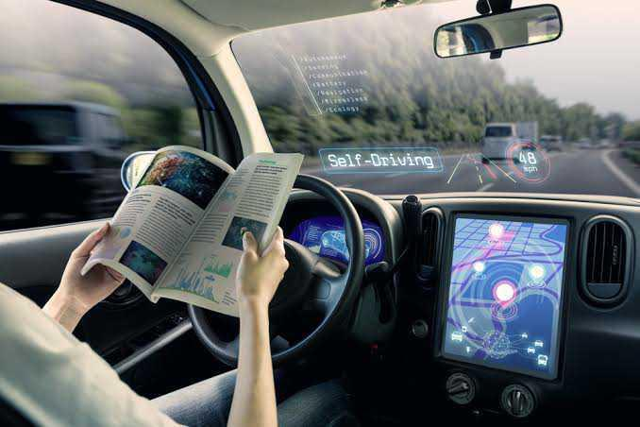
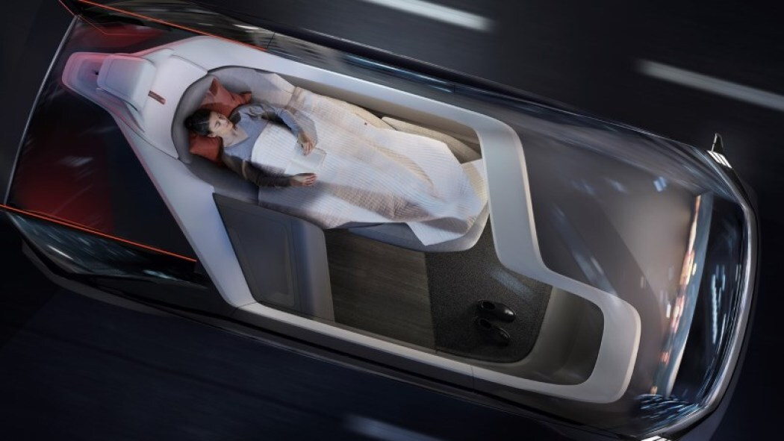
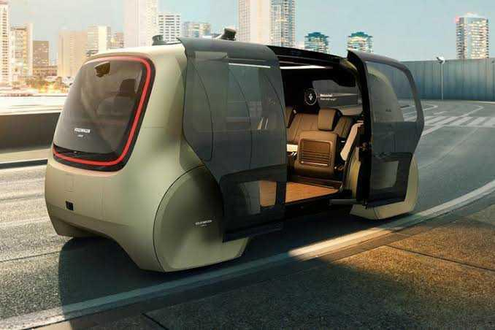
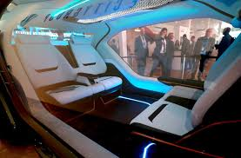
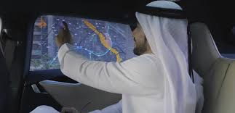
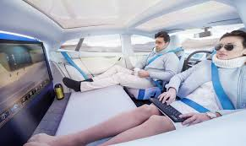
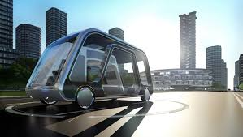
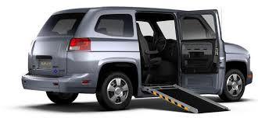
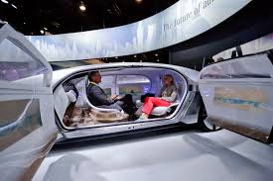
Facebook Ads
 | Facebook Ad 1: | Facebook Ad 2 | Facebook Ad 3 | Facebook Ad 4 | Facebook Ad 5
Title | Don’t waste your precious time waiting for the bus! | Commute Faster Even Whilst You Sleep | Are you designated driver-AGAIN? | In Us You Trust! | Convenience in its finest and feel the luxury
Description | You can do more in the go | It’s faster even your dreaming | Relax! Have a drink! | Be smart! Use our robot! | Enjoy and relax on your ride
Visual | someone reading a book Image | Image of someone resting whilst being driven | Image of a futuristic automated bus | Robot driver focusing on driving. | Image of tourism automated car
Photo 1
Photo 2
Target Audience | Efficiency Minded Commuter Working professionals in major Australian cities aged 18-65 (1M audience size) | Business and chauffeured Commuter Travelers aged 18-45 (8.6M audience) | Party Goer Commuter Students in Australia aged 18-25 (1.8M audience size) | Disabled Commuter Seniors (Australia and Asia) - 8M audience size People with illness | Tourist Commuter Travelers in Australia aged 18-35 (5,9M audience) Influencers aged 18-35 (4.1M audience size)
Notes:
Insert tabel of 5 different ads

Slide 10
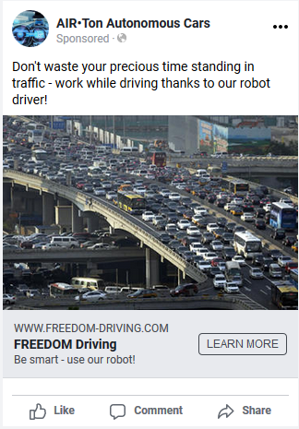
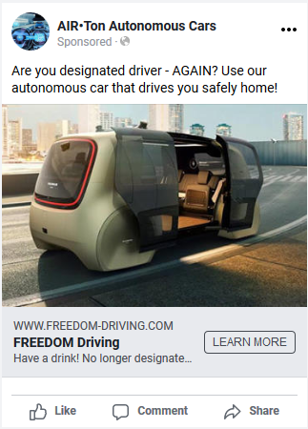
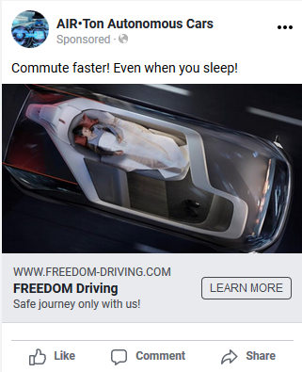
Sample Facebook Ads

Slide 11
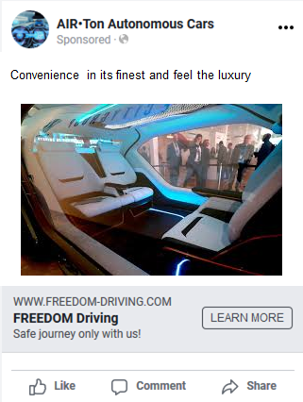
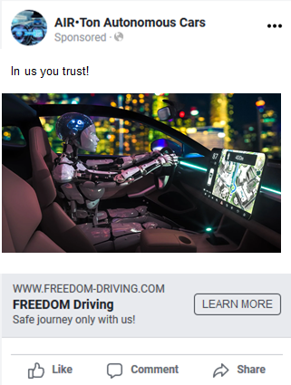
Sample Facebook Ads

Slide 12
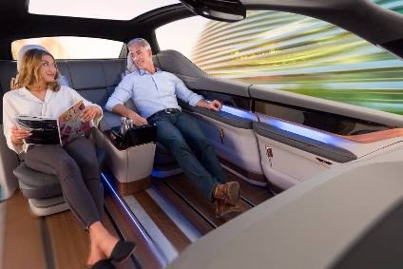
Benefits of Using AIR·Ton
Quicker and more efficient travel
Safer as people do not have to get into Ubers and risk catching COVID
Convenient for people traveling to placed where they do not know anyone
Comfort : people can travel across the country while they sleep.
Having a chauffeur to the parties/business meetings (using Butler mode) with privacy.

